Slide 1
Mathematics for Business Analytics and Finance
Sami Najafi
MSIS2402/2502
Module 0

Slide 2
Introduction
Sami Najafi
MS, Industrial Engineering
Sharif University of Technology, Tehran, Iran
MS and PhD, Management Science and Operations
London Business School (LBS), London, UK
Postdoctoral Fellow in Operations Management
University of Toronto , Toronto, Canada
Associate Professor of Operations Management at Leavey
Research interests:
Stochastic Modelling, Optimization
Pricing and Revenue Management, Service Operations
Operations-Marketing interface: Online Advertising

Slide 3
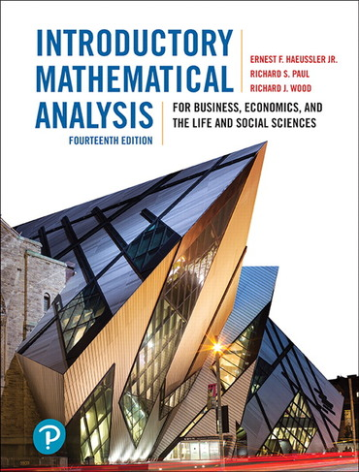
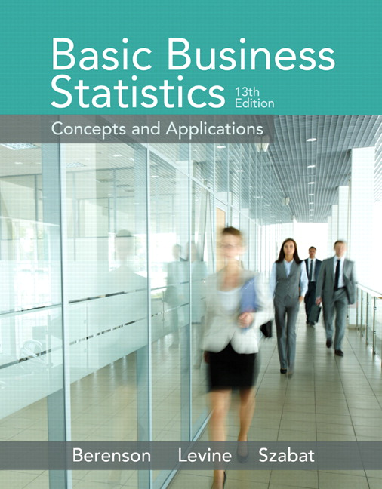
Course Material
Lecture slides, excel files, and all other teaching materials:
Posted on the course page
Recommended Optional Textbooks:
Modules 1-4: Introductory mathematical analysis for business, economics and the life and social sciences (14th Ed.)
By by Ernest F Haeussler, Richard S. Paul, Richard J. Wood. Pearson (July 24th 2018)
Modules 5-9: Basic business statistics: Concepts and applications. Pearson higher education (13th Ed.).
Berenson, M., Levine, D., Szabat, K. A., & Krehbiel, T. C. (2014). Pearson (2014)

Slide 4
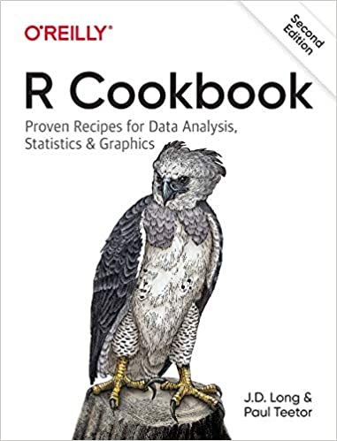
Course Material
Recommended book for R:
R Cookbook: Proven Recipes for Data Analysis, Statistics, and Graphics, 2nd edition
By J.D. Long and Paul Teetor (2019)

Slide 5
Course Assessment
Fair grading, and communicating clearly the expectations of the course
Participation 5%
2 Quizzes 15%
Given on Weeks 4 and 8
Midterm Exam 25%
Given on Week 6
Take home online
Group Projects 20%
Given on Week 7
Final Exam 35%
Given on Week 10
Take home online

Slide 6
Course Objectives
Students will learn several tools and techniques in:
Single variable calculus
Matrix algebra
Multivariable calculus and optimization
Probability and statistics
That are required to understand various quantitative topics in analytics, finance, marketing and economics.

Slide 7
Course Outline

Slide 8
A Preliminary Introduction to R Programming

Slide 9
Some Basics

Slide 10
Entering Commands and Getting Help
Using R as A Calculator
> 1+1
[1] 2
> max(1,3,5)
[1] 5
> pi
[1] 3.141593
> sqrt(2)
[1] 1.414214
To know more about a function:
> help("mean") or > ?mean
> example(mean)

Slide 11
Printing Something
Print
print(x,number of digits)
Print(“expression”)
> print(sqrt(2),4)
[1] 1.414
The only way to print multiple items is to print them one at a time
> print("The zero occurs at"); print(2*pi); print("radians")
[1] "The zero occurs at"
[1] 6.283185
[1] "radians"

Slide 12
Printing Something
Concatenate
cat(num1/expr1, num2/expr2,…) combines multiple items into a continuous output
> cat("The zero occurs at", 2*pi, "radians.", "\n")
The zero occurs at 6.283185 radians.
> fib = c(0,1,1,2,3,5,8,13,21,34)
> cat("The first few Fibonacci numbers are:", fib, "...\n")
The first few Fibonacci numbers are: 0 1 1 2 3 5 8 13 21 34 ...
> iter=1
> cat("iteration = ", iter = iter + 1, "\n")
iteration = 2

Slide 13
Variables and Vectors

Slide 14
Variables
Defining Variables
Assignment operators: <- , <<- , = , -> , ->>.
> x <- 3
> z <- sqrt(x^2)
> print(z)
[1] 9
> f = 3
> print(f)
[1] 3
> 5 -> u
> print(u)
[1] 5

Slide 15
Variables
Deleting a Variable
rm(x) removes the variable
> x <- 2*pi
> x
[1] 6.283185
> rm(x)
> x
Error: object "x" not found

Slide 16
Vectors
Creating and Combining Vectors
c(first number or string,…,last number or character)
> c(1,1,2,3,5,8,13,21)
[1] 1 1 2 3 5 8 13 21
> c(1*pi, 2*pi, 3*pi, 4*pi)
[1] 3.141593 6.283185 9.424778 12.566371
> c("Everyone", "loves", "stats.")
[1] "Everyone" "loves" "stats."
Combining two vectors:
> v1 = c(1,2,3)
> v2 = c(4,5,6)
> c(v1,v2)
[1] 1 2 3 4 5 6

Slide 17
Vectors
Computing Basic Statistics
mean(x), median(x), sd(x) var(x), cor(x,y), cov(x,y), range(x), quantile(x)
summary(x) gives some of the summary statistics
> x = c(0,1,1,2,3,5,8,13,21,34)
> y = log(x+1)
> mean(x)
[1] 8.8
> median(x)
[1] 4
> sd(x)
[1] 11.03328
> summary(x)
Min. 1st Qu. Median Mean 3rd Qu. Max.
0.00 1.25 4.00 8.80 11.75 34.00

Slide 18
Vectors
Creating Sequences
seq(from, to) or from:to
seq(from, to, by= )
seq(from, to, length= )
rep(number, number of repetitions)
> 10:19
[1] 10 11 12 13 14 15 16 17 18 19
> 9:0
[1] 9 8 7 6 5 4 3 2 1 0
> seq(from=0, to=20)
[1] 0 1 2 3 4 5 6 7 8 9 10 11 12 13 14 15 16 17 18 19 20
> seq(from=0, to=20, by=2)
[1] 0 2 4 6 8 10 12 14 16 18 20
> seq(from=1.0, to=2.0, length=5)
[1] 1.00 1.25 1.50 1.75 2.00

Slide 19
Vectors
Comparing Numbers and Vectors
The comparison operators compare two values and return TRUE or FALSE.
For two vectors, the comparison is component-wise. The result is a logical vector.
> a = 3
> a == pi
[1] FALSE
> a != pi
[1] TRUE
> a < pi
[1] TRUE
> v = c( 3, pi, 4)
> w = c(pi, pi, pi)
> v == w
[1] FALSE TRUE FALSE

Slide 20
Vectors
Comparing Numbers and Vectors
any(v == w) Return TRUE if any element of v equals the same element in w
all(v == w) Return TRUE if all element of v equals the same element in w
any(v == num) Return TRUE if any element of v equals the value num
all(v == num) Return TRUE if all element of v equals the value num
> v = c(3,pi,4)
> w = c(pi,pi,pi)
> v != w
[1] TRUE FALSE TRUE
> v <= w
[1] TRUE TRUE FALSE
> v != 3
[1] FALSE TRUE TRUE
> any(v != 3)
[1] TRUE

Slide 21
Vectors
Choosing Vector Elements
vec[a] Select element a
vec[a:b] Select elements a through b
vec(c(a,b,c)) Select elements a,b, and c.
vec(-a:-b) or vec(-(a:b)) exclude elements a through b
> fib = c(0,1,1,2,3,5,8,13,21,34)
> fib[6]
[1] 05
> fib[4:9]
[1] 2 3 5 8 13 21
> fib[c(1,2,4,8)]
[1] 0 1 2 13
> fib[-1:-5]
[1] 5 8 13 21 34

Slide 22
Vectors
More Complex Element Selections
Vec[vec<=a] Select elements that are not greater than a
Vec[vec>=a&vec<=b] Select elements that are between a and b inclusively
More complex element selections can be coded similarly.
> fib = c(0,1,1,2,3,5,8,13,21,34)
> fib[fib < 10] # Use that vector to select elements less than 10
[1] 0 1 1 2 3 5 8
> fib[fib > mean(fib)] # Use that vector to select elements less than 10
[1] 13 21 34
> fib[fib<=5|fib>=21] # | means “or”
[1] 0 1 1 2 3 5 21 34
> fib[fib>5&fib<21] # | means “and”
[1] 8 13
> w=c(1,2,4,3,5,6,8,2,7,0)
> fib[w>5]
[1] 5 8 21

Slide 23
Vectors
Arithmetic Operations
+, -, *, /, ^: These arithmetic operations are component-wise
> v = c(11,12,13,14,15)
> w = c(1,2,3,4,5)
> v + w
[1] 12 14 16 18 20
> v - w
[1] 10 10 10 10 10
> v * w
[1] 11 24 39 56 75
> v / w
[1] 11.000000 6.000000 4.333333 3.500000 3.000000
> w ^ v
[1] 1 4096 1594323 268435456 30517578125

Slide 24
Vectors
Arithmetic Operations between a Vector and a Scalar
The operation is performed between every vector element and the scalar
> w + 2
[1] 3 4 5 6 7
> w - 2
[1] -1 0 1 2 3
> w * 2
[1] 2 4 6 8 10
> w / 2
[1] 0.5 1.0 1.5 2.0 2.5
> w ^ 2
[1] 1 4 9 16 25
> 2 ^ w
[1] 2 4 8 16 32

Slide 25
Performing Vector Arithmetic
Operation of Functions on Vectors
Functions operate on every element. The result is a vector.
> w
[1] 1 2 3 4 5
> sqrt(w)
[1] 1.000000 1.414214 1.732051 2.000000 2.236068
> log(w)
[1] 0.0000000 0.6931472 1.0986123 1.3862944 1.6094379
> sin(w)
[1] 0.8414710 0.9092974 0.1411200 -0.7568025 -0.9589243

Slide 26
Vectors
More Vector Arithmetic
m%%n Modulo operator (gives the remainder of m/n)
%/% Integer division (gives the integer part of m/n)
%*% Matrix multiplication (to be studied later)
%in% Returns TRUE if the left operand occurs in its right operand; FALSE otherwise
> 14%%5
[1] 4
> 14%%5
[1] 2
> 5%in%14
[1] FALSE
> 5%in%c(5,4)
[1] TRUE

Slide 27
Functions, Loops, Matrices, and Lists

Slide 28
Functions
Defining a Function
function(param1, ...., paramN) expr
function(param1, ..., paramN) {
expr1
.
.
.
exprM
}
> cv = function(x) sd(x)/mean(x)
> cv(1:10)
[1] 0.5504819
s=function(n){
if(n>=5) return (2*n)
if((n>=0)&&(n<5))return (n)
else return (3*n)
}
> s(3)
[1] 3

Slide 29
Loops
Creating Loops
for (variable in vector) {
expressions
}
while (condition) {
}
> factorial=1
> for (i in 1:5) {factorial = factorial *i}
> factorial
[1] 120
> while(i>=1){print(i);i=i-1}
[1] 3
[1] 2
[1] 1

Slide 30
Matrices
Creating a Matrix
Mat=matrix(c(a1,…,an),nrow=,ncol=,byrow=)
dim(Mat) given the matrix dimension
> mat=matrix(c(1,2,3,4),2,2,byrow=1)
> mat
[,1] [,2]
[1,] 1 2
[2,] 3 4

Slide 31
Lists
Creating a List
ls=list(num1/exp1,num2/exp2,…)
> m= matrix(list(1,2,"x",3,"y",4),2,3,byrow=1)
> m
[,1] [,2] [,3]
[1,] 1 2 "x"
[2,] 3 "y" 4
m[[1,1]]+3
[1] 4
> s=c(m[[1,3]],"t")
> s
[1] "x" "t"

Slide 32
Input and Output

Slide 33
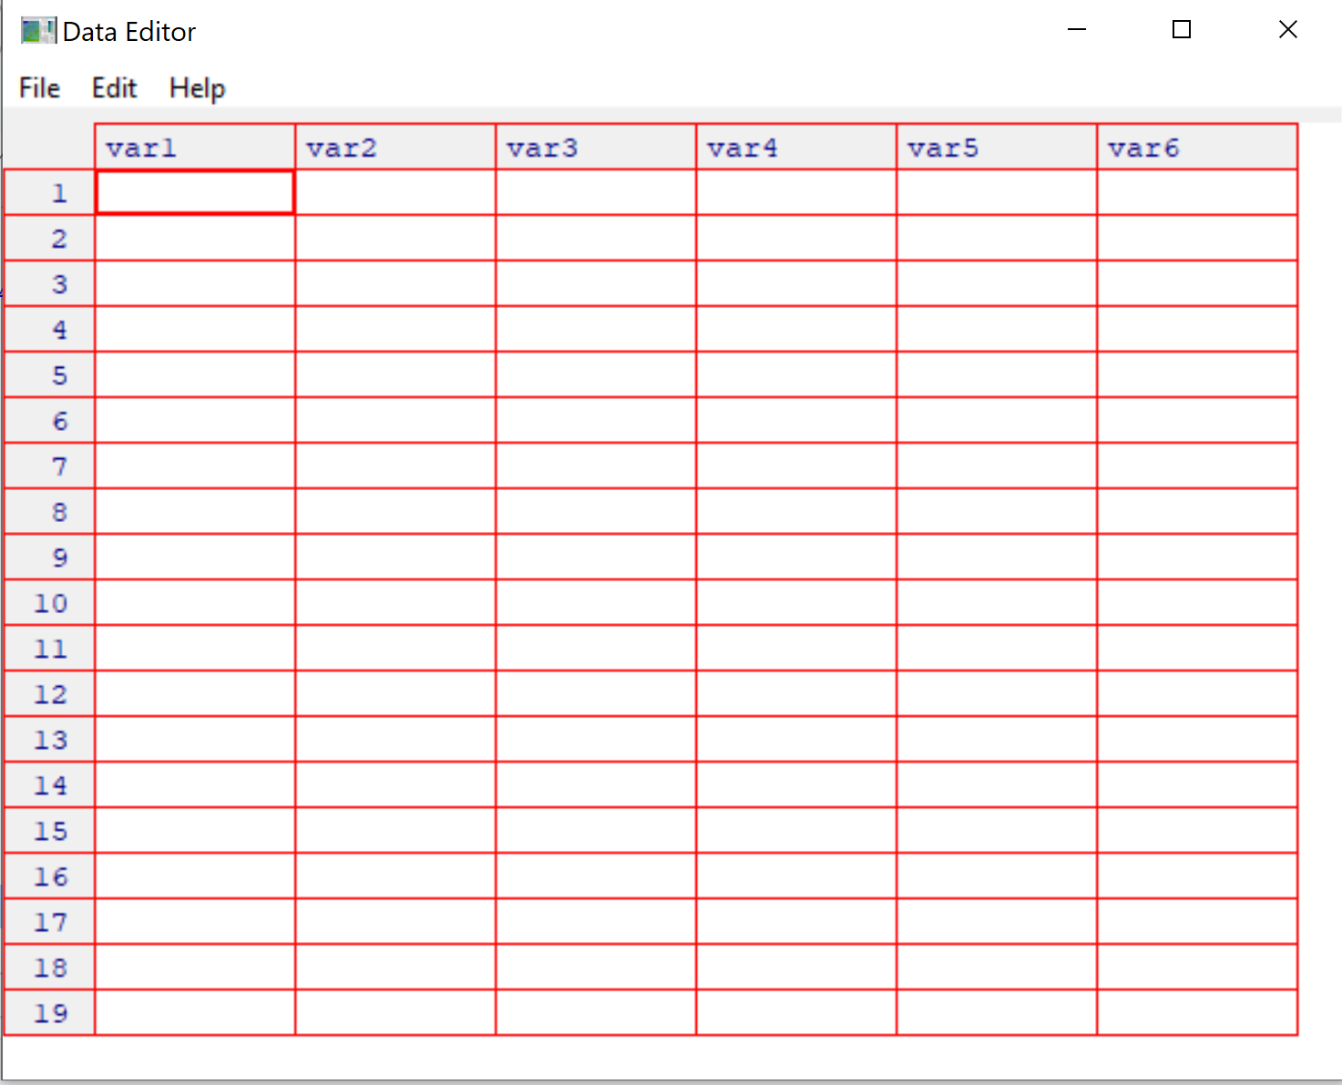
Input and Output
Entering Data from the Keyboard
For very small datasets, use the c() for vectors.
You can also create an empty dataset (data frame) and then use “edit” to fill it
> scores <- c(61, 66, 90, 88, 100)
> scores <- data.frame() # Create empty data frame
> scores <- edit(scores) # edit the data frame

Slide 34
Input and Output
Creating a Dataset on Keyboard
nameofdataframe = data.frame(
var1=c(…),
var2=c(…),
var3=c(…)
)
scores = data.frame(
label=c("Low", "Mid", "High"),
lbound=c( 0, 0.67, 1.64),
ubound=c(0.674, 1.64, 2.33)
)
> scores
label lbound ubound
1 Low 0.00 0.674
2 Mid 0.67 1.640
3 High 1.64 2.330

Slide 35
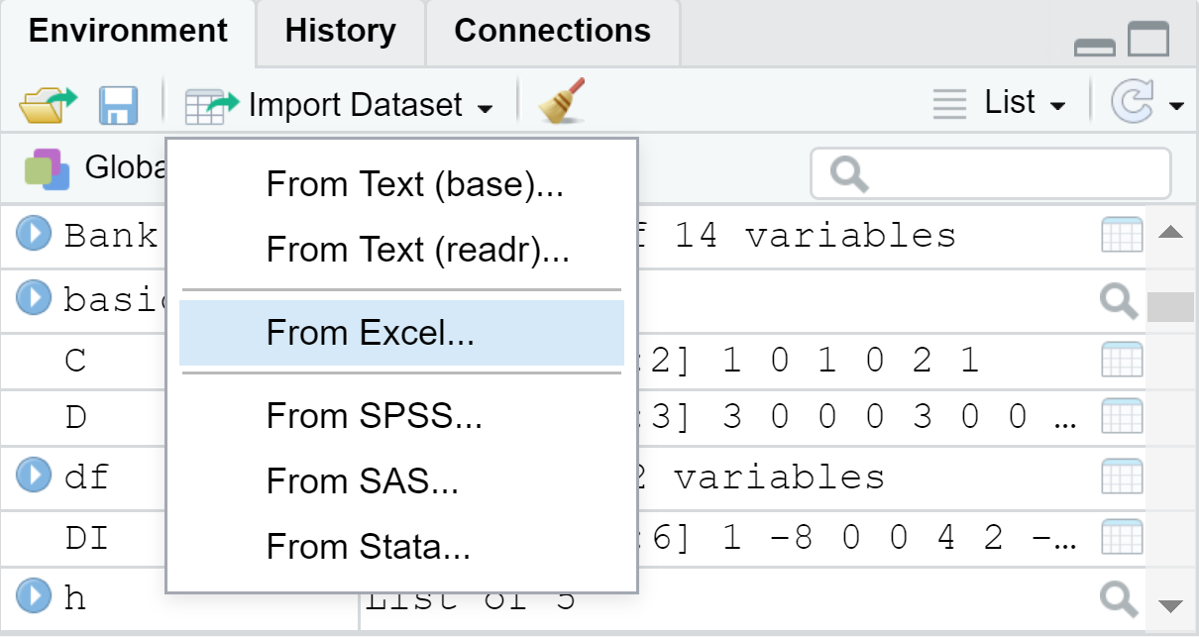
Input and Output
Importing a Dataset From Excel
library(readxl)
Data_name = read_excel(“enter the address of the excel file", + sheet = “enter the sheet name")
An easier way: Import Dataset → From Excel
> library(readxl)
> Bank <- read_excel(“address…", + sheet = “mysheet")
> View(Bank)
(Use the posted UniversalBank.xlsx to practice these codes)

Slide 36
Input and Output
Exporting a Dataset (Data Frame) in Excel
library(writexl)
write_xlsx(list(Nameofsheet1 = dataforsheet1,
Nameofsheet2 = dataforsheet2,
Nameofsheet3 = dataforsheet3),
"filename.xlsx")
> library(writexl)
> write_xlsx(list(mysheet=df, mysheet2=df),"C:/Users/Vortex/Dropbox/Math course/Bank5.xlsx")

Slide 37
Some Other Statistical Tools

Slide 38
Some Other Statistical Tools
Choose a Random Sample
sample(x, size, replace = FALSE)
x: the vector
size: size of the sample
relace: False/True whether the sample is with replacement or not
In the UniversalBank.xlsx case, after importing the dataset as a new data frame Bank, we can code like this:
> sample(Bank$ID,10)
[1] 1981 3717 2055 1622 868 2893 4634 1231 1202 385

Slide 39
Some Other Statistical Tools
Generating a Random Sequence
sample(x, size, replace = TRUE,Prob)
x: the vector
size: size of the sample
relace: False/True whether the sample is with replacement or not
Prob: a vector of probability weights for obtaining the elements of the vector being sampled.
> sample(c("H","T"),10,replace=TRUE,c(0.5,0.5))
[1] "T" "T" "T" "H" "H" "T" "H" "T" "T" "H"

Slide 40
Some Other Statistical Tools
Tabulating and Creating Contingency Tables
table(x) create a summary table based on different categories in x
Table(x,y) creates a contingency table
x, y: categorical variables
> table(Bank$Family)
1 2 3 4
1472 1296 1010 1222
> table(Bank$Family,Bank$Education)
1 2 3
1 678 326 468
2 657 265 374
3 349 383 278
4 412 429 381

Slide 41
Some Other Statistical Tools
Testing Categorical Variables for Independence
summary(table(x,y)) creates a contingency table
x, y: categorical variables
> summary(table(Bank$Family,Bank$Education))
Number of cases in table: 5000
Number of factors: 2
Test for independence of all factors: Chisq = 169.01, df = 6, p-value = 7.288e-34
Remark: The small p-value (e.g., p-value<0.05) indicates that the two factors are probably not independent. Practically speaking, we conclude there is some relationship between the two variables.

Slide 42
Some Other Statistical Tools
Converting Data to Z-Scores
scale(x)
x: a vector
> v=scale(Bank$Income)
> v[1:5]
[1] -0.5381750 -0.8640230 -1.3636566 0.5697084 -0.6250678

Slide 43
Some Other Statistical Tools
Testing the Mean of a Sample (t Test)
t.test(x, mu=m)
x: a vector
m: the hypothesized mean value for the data
> t.test(Bank$Income,mu=50)
One Sample t-test
data: Bank$Income
t = 36.519, df = 4999, p-value < 2.2e-16
alternative hypothesis: true mean is not equal to 50
95 percent confidence interval: 72.49792 75.05048
sample estimates:
mean of x 73.7742
Remark: The small p-value (e.g., p-value<0.05) indicates that the population mean is different from the hypothesized value mu.

